Slide 1
#3 Operators in Java
Bitwise Operators

Slide 2
Bit – wise Operators
These types of operators works on bits.(0 and 1).
There are seven types of Bitwise operators.
They act only on integer data types (short, byte, int and long).

Slide 3
Bitwise (Complement) Operator
Simply converts the number in to binary form and then invert all the bits (covert 0 to 1 and 1 to 0).
Its sign is (~). Pronounced as tilde.
X = 10 (0000 1010)
~X = -11 (1111 0101)

Slide 4
Bitwise (and) operator
Performs the “and” operation on the individual bits.
Its symbol is ‘&’.
X = 10 (0000 1010)
Y = 11 (0000 1011)
X&Y = 0000 1010
Output: 10 in decimal
X | Y | X & Y
0 | 0 | 0
0 | 1 | 0
1 | 0 | 0
1 | 1 | 1

Slide 5
Bitwise (or) operator
Its symbol is “|”.
X = 10 (0000 1010)
Y = 11 (0000 1011)
X&Y = 0000 1011
Output: 11 in decimal
X | Y | X & Y
0 | 0 | 0
0 | 1 | 1
1 | 0 | 1
1 | 1 | 1

Slide 6
Bitwise (xor) operator
Its symbol is “^”.
Also called as exclusive or.
X = 10 (0000 1010)
Y = 11 (0000 1011)
X&Y = 0000 0001
Output: 1 in decimal
X | Y | X & Y
0 | 0 | 0
0 | 1 | 1
1 | 0 | 1
1 | 1 | 0

Slide 7
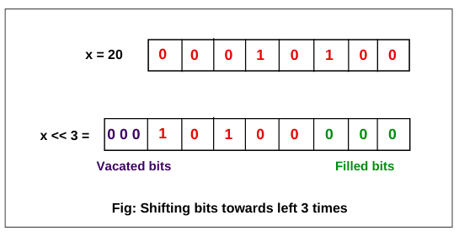
Bitwise (Left Shift) operator
Its symbol is “<<”.
Read as double less than.
X = 20
X << 3
Output in Decimal:
160

Slide 8
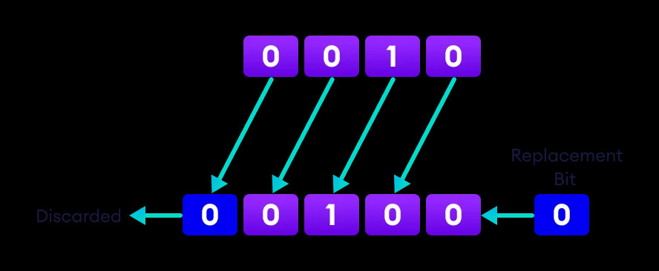
Bitwise (Left Shift) operator
X = 2
X << 1
Output in decimal:
4

Slide 9
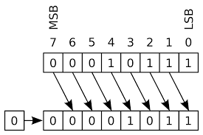
Bitwise (Right Shift) operator
Its Symbol is “>>”.
Read as double greater than.
X = 23
X >> 1
Output in Decimal:
11

Slide 10
Priority of Operators
Values inside the brackets: {}, [], ()
Increment ++ and Decrement Operators --;
*, /, % will execute.
+, - will execute.
Relational Operators.
Boolean and Bitwise Operators.
Logical Operators.
Assignment Operators.

